Slide 1
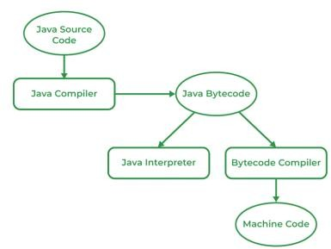
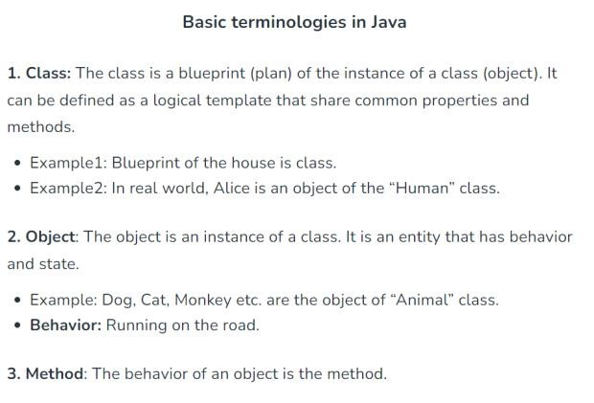
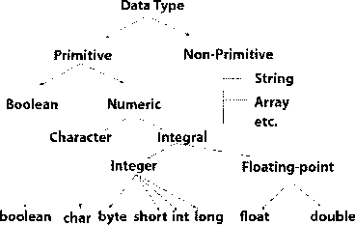
Puzzle +Java Topics to Covered
18 August 2023 07:36
Puzzle -1
T20 Match
Puzzle -2
Cross the bridge (1 ,2 ,5 ,8)
What is algorithms? 2.Why java?
Basics syntax
Comments in java
Single line
Multi line
Variables in java
How to declare a variable
Variable name start with(character only,_)
Operators
Decision making
Loops
3.why OOPs
How JAVA code executed

Slide 2
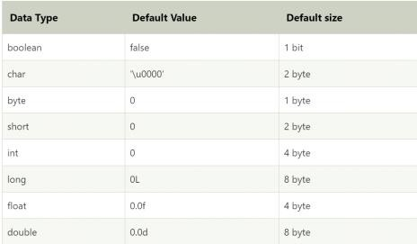
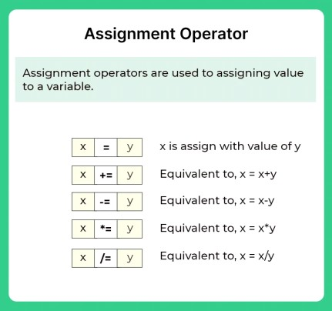
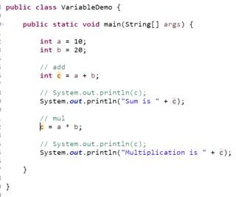
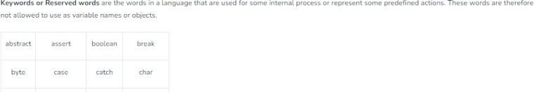
Some Basics Program Practice
Print number
Print String
And many more
We cannot re-initialize variable with the same name
Q) Simple Interest Program.(p=1000,R=5,T=2) Ans:-(1000*5*2)/100=100;

Slide 3
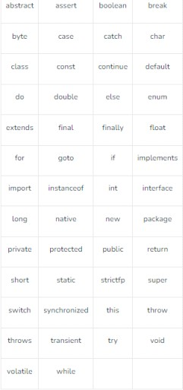
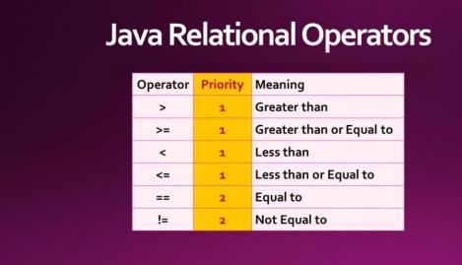
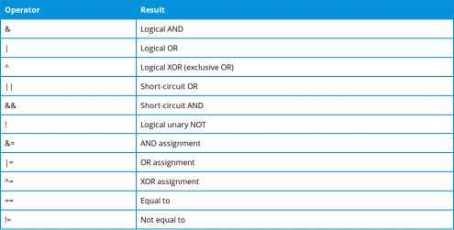
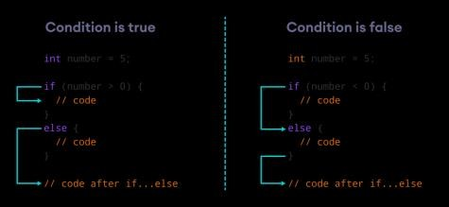
Q) EVEN ODD Program

Slide 4
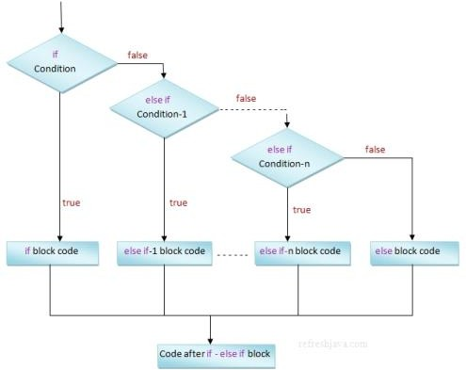
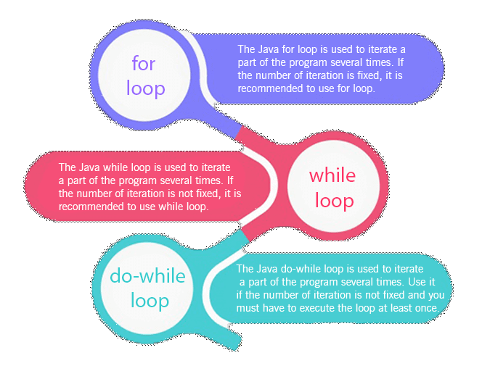
Operators (&&,|| and more)
Q)fizz, buzz pint
->if elseif else
Topic:-
take input from user using scanner
class
Integer input
String input
Float input
Double input
LOOP(4 class)
For loop
While loop
Do while loop
Diff between
break
continue
return
Modulo operator(%)
Q)Sum of n natural numbers
Prime number Code
Print digits of a number
Sum of all digits of a number
Armstrong Number
Max of all the digits of a number
Reverse the number
GCD of number
Fibonacci series
Pattern Practice Question( one week)
P1
P2
P3
……p33
Type conversion
Binary to decimal Q.)Assignment 1(CB)
GCD
Prime Number
Nth Fibbonacci
Sum of Digits of number
Q)Assignment 2(All must be solved using function)

Slide 5
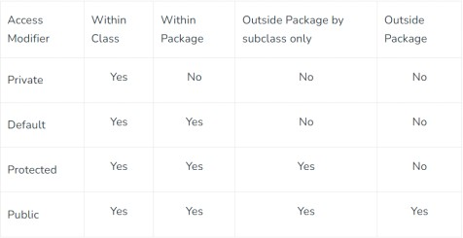
Pattern Question (Practice by students)
Function
How to define a function
Inbuilt function
Arrays
1-D arrays
Array declaration
Taking user input in array
Array printing
Find odd even in an array
Reverse printing of an Array
All Question must be solved using function
Max in array(inbuilt (inbuilt max function)
Min in array(inbuilt min function)
Check Palindrome in Array
Reverse Array (3 Approach)
Rotate array(2 Approach)
Inverse of an array
Odd even count
8.
Searching
Linear search
Binary search
9.
Sorting(inbuilt sort function)
Insertion
Bubble
Selection
10.
SubArray sum Concept
11.
a. Max subarray sum
Swapping
Pass by value
Pass by reference
Pass by index
○
2-D arrays
Matrix representation
Take input in matrix
Matrix print
Wave print
Spiral print
Search in 2D array
String and String Builder
Understanding Access Modifiers:

